Slide 1

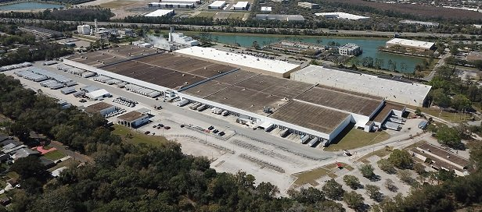
Business Management
BCS 230 - 90111 - Fall 2021 - Farmingdale State College
Team 4
Mujeeb Moiz
Gionny Yglesia
Cameron Glenn
Kevin Kenna

Slide 2




Meet the Team
Mujeeb Moiz
General Manager &
Senior Programmer
Gionny
Yglesia Junior Programmer & Powerpoint Designer
Cameron
Glenn Flow Chart Author & Algorithms Designer
Kevin
Kenna
Data Research Specialist & Powerpoint Author

Slide 3




Checkmate Distribution: Mission Statement
Here at Checkmate Distribution™, we believe that the process of purchasing inventory for retail purposes should be a simple, efficient, and low-cost process so we developed and patented our innovative CheckDis™ System which allows companies to place orders for products that are then complied with orders from other companies in order to reduce overall bulk pricing from manufacturers in higher quantities.
Checkmate Distribution

Slide 4

CheckDis™ System
Place Orders for specific Contracted Models in Exact Quantities
Calculate Totals for Individual Models, Grand Totals, & Estimated Shipping Dates
All Invoices Are Saved in Text Files for Easy Access on Users End

Slide 5

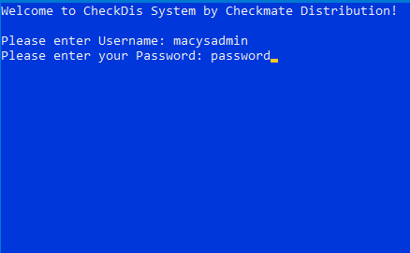

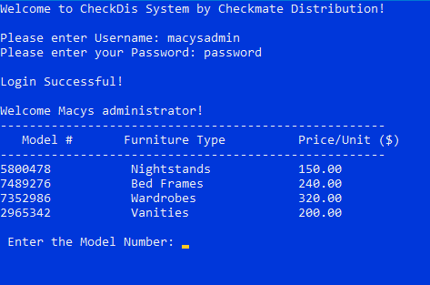
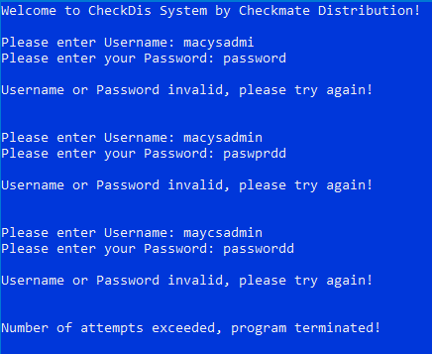

Login:
Initial Screen
Successful Attempt
Failed Attempt

Slide 6
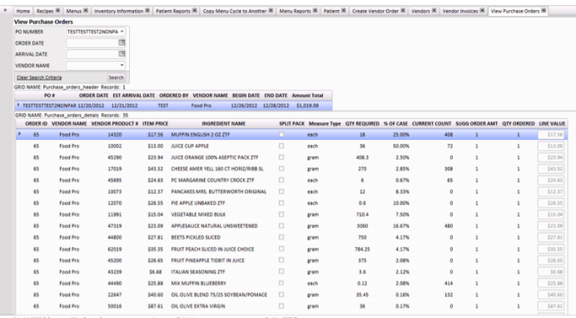
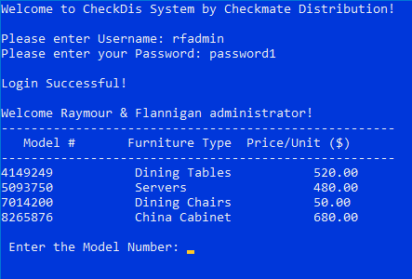
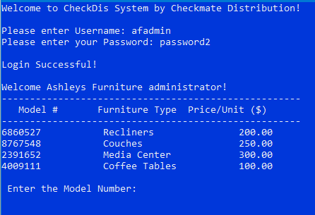
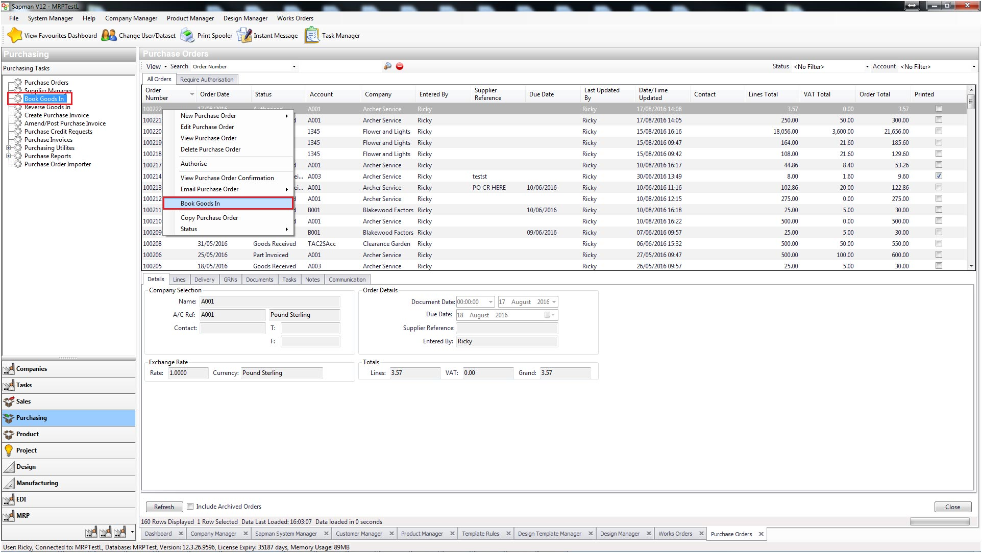
Menus:
Macys
Raymour & Flannigan
Ashley's Furniture

Slide 7

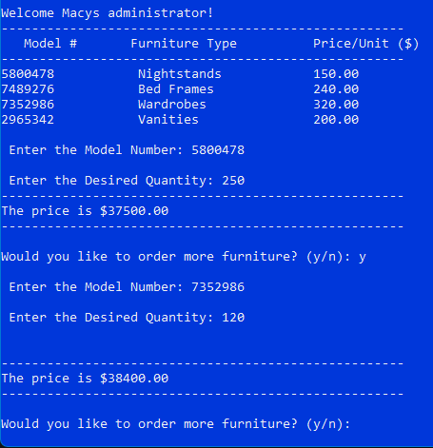
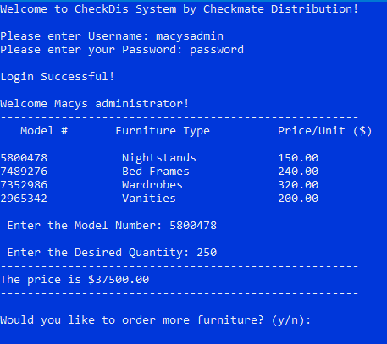
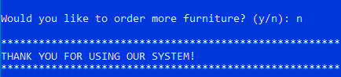
Purchasing Inventory:
Consecutive Orders
Product Menu
First Order

Slide 8

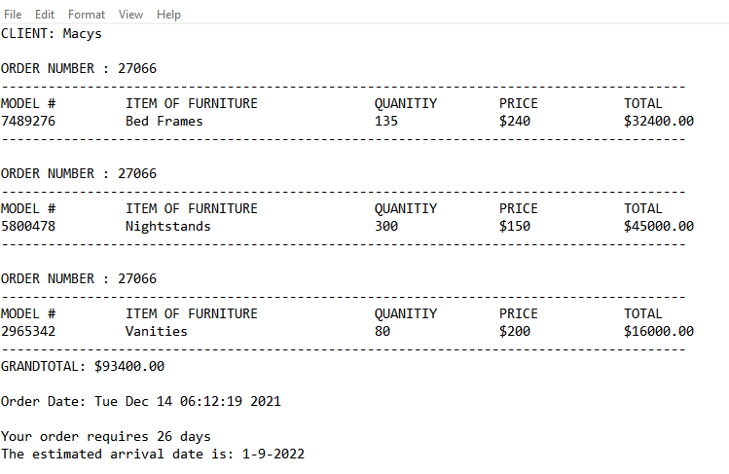

Saved Invoice/Shipping File:
Client ID
Order # is Generated
All Individual Models & Quantities are Recorded
Order Total & Estimated Shipping Date are Calculated and Saved

Slide 9

Thank You!
Questions?
Comments?
Concerns?

